Slide 1


B.A.H.T
BUSINESS ACADEMY OF Hospitality & TOURISM
Notes:
Play the slide show for this presentation to listen to the audio commentary by Peter Walsh and view slide timings. Or, click the sound icon on a slide for controls that you can use to hear the audio at your own pace.
A little organization will go a long way to enhancing your PowerPoint presentation.
Your title slide should be catching and relevant to your audience – offer something in the title that your audience wants.
Keep some basic principles in mind:
Your slides should complement what you have to say, not say it for you.
Keep slides direct and to the point - less is more!
Choose a background color or design that enhances and complements your presentation rather than competes with it.
Don’t get too fancy - a simple font, elegant color scheme and clear message is more important than lots of information (clutter!) on the slide.
Keep it simple! The purpose of the PowerPoint slide is to keep the mind of your audience focused – fewer words are better.
Note: You understand that Microsoft does not endorse or control the content provided in the following presentation.

Slide 2

Four Core Components of Linked Learning
Rigorous Academics
All Classes A-G approved
Career Technical Education
Work Based Learning
Comprehensive Support Services

Slide 3

21st Century Skills BAHT Provides
Critical Thinking
Creativity
Collaboration
Communication

Slide 4
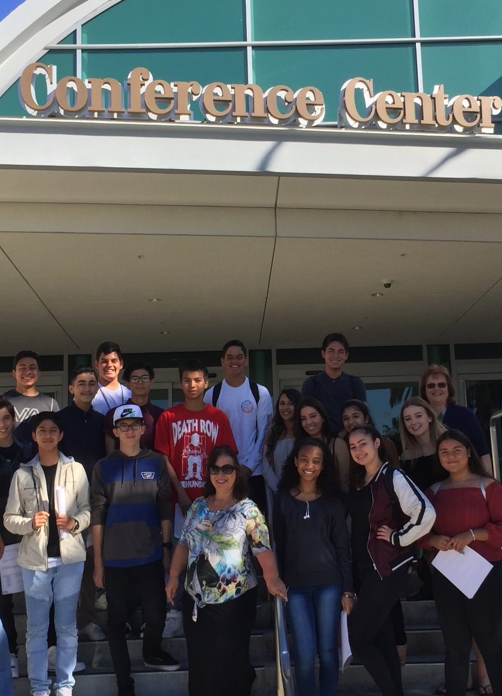
Opportunities B.A.H.T. Students
Exciting Field Trips
Project Based Learning
School Based Enterprise
Certificate of Achievement
Career Technical Student Organization (CTSO)
Articulation Agreements
Graduation recognition
Job Shadowing and Internships

Slide 5
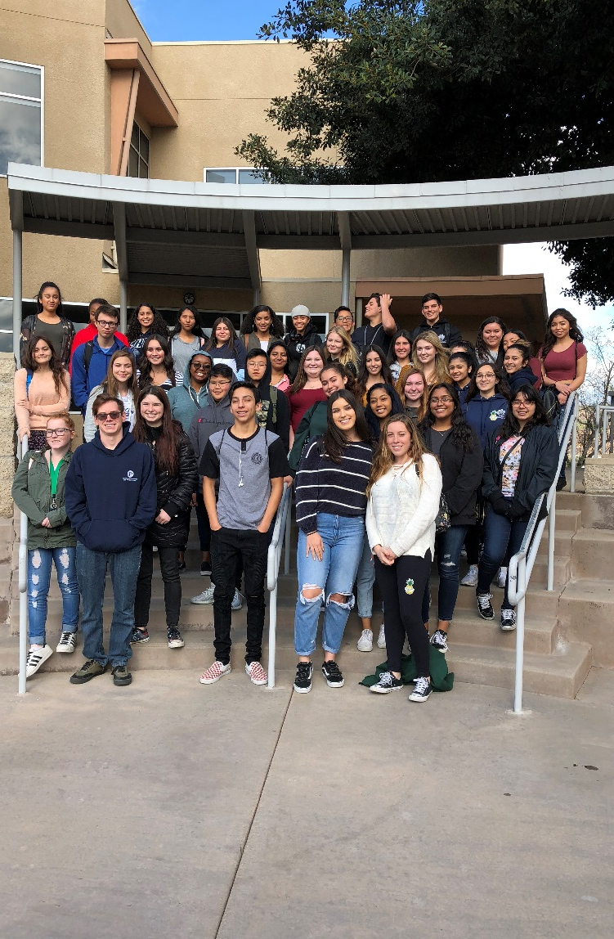
Career Related Field Trips
Cal Poly Pomona
Chaffey College
Cal State Fullerton
Sheraton Fairplex
Disney Grand California
Sysco Food Service
Garden Walk Anaheim

Slide 6
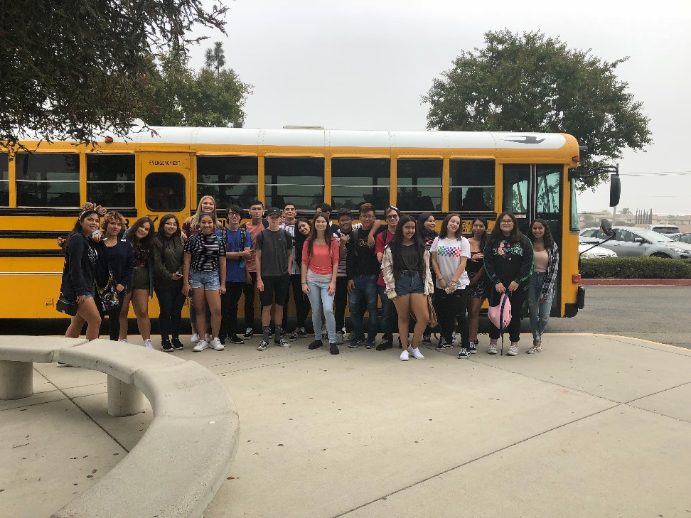
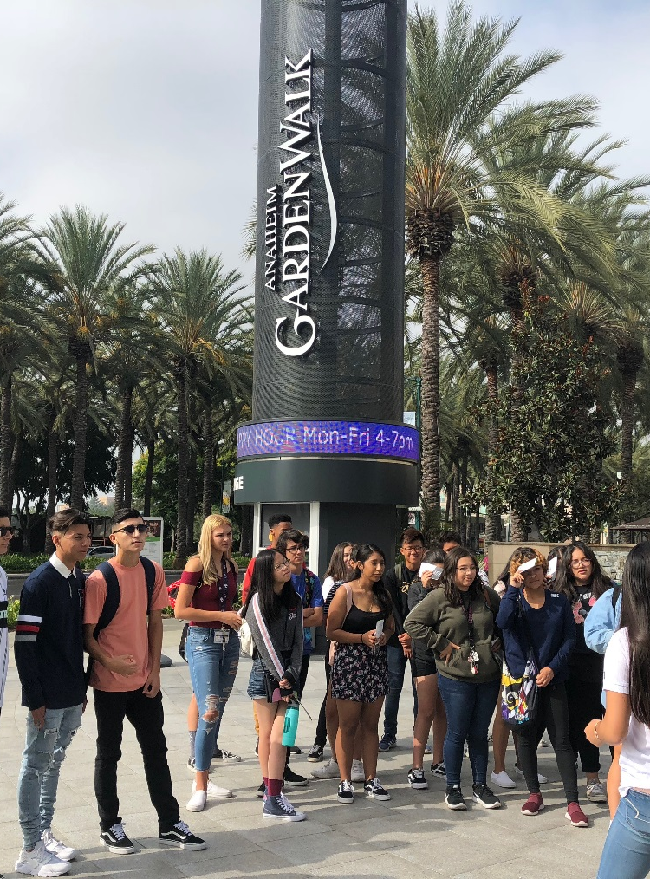

Career Related Field Trip

Slide 7
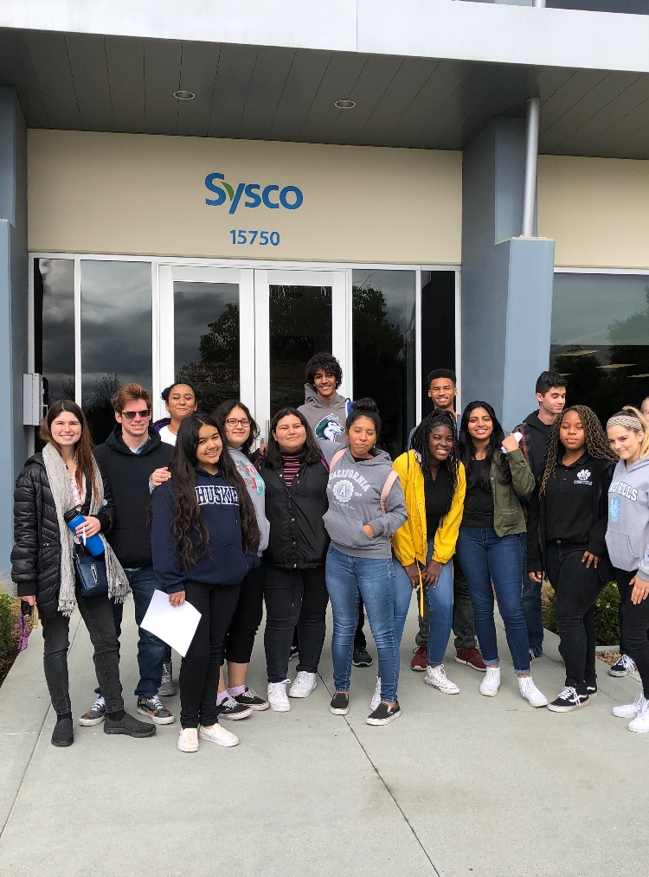
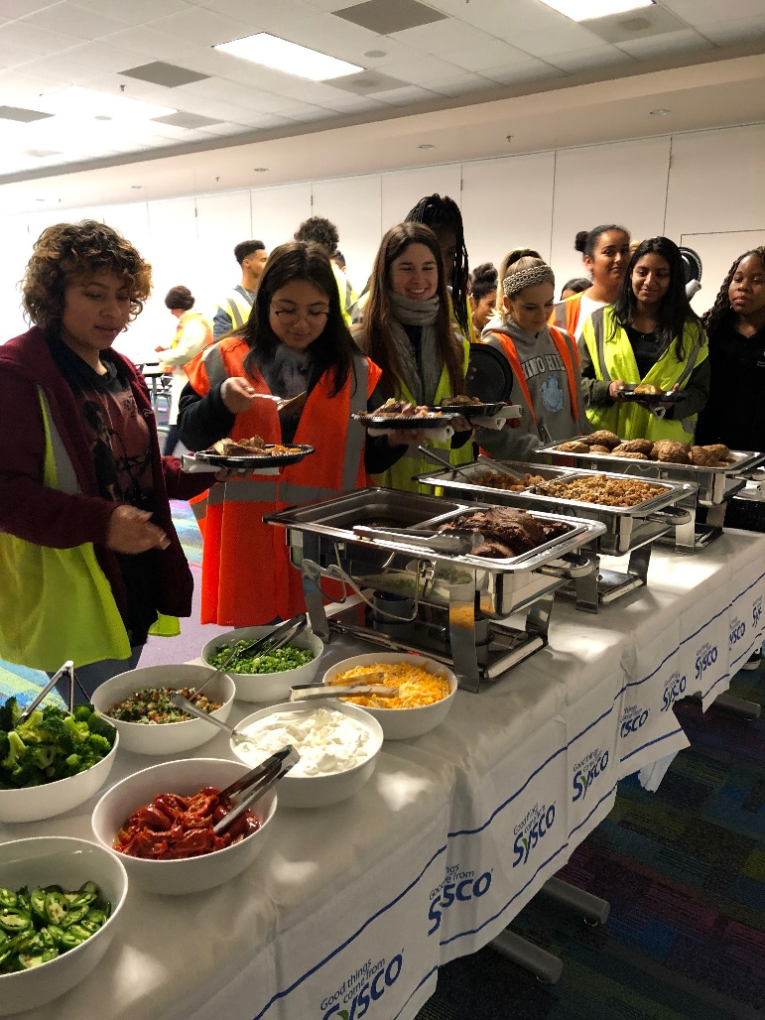
Career Related Field Trips

Slide 8
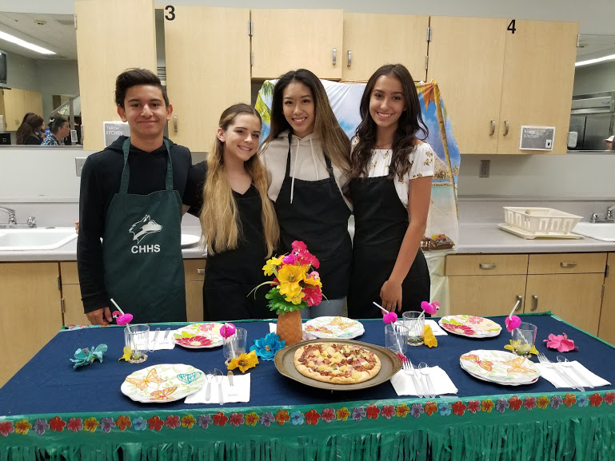
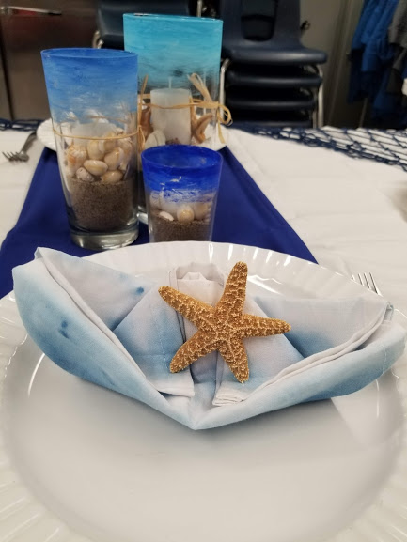
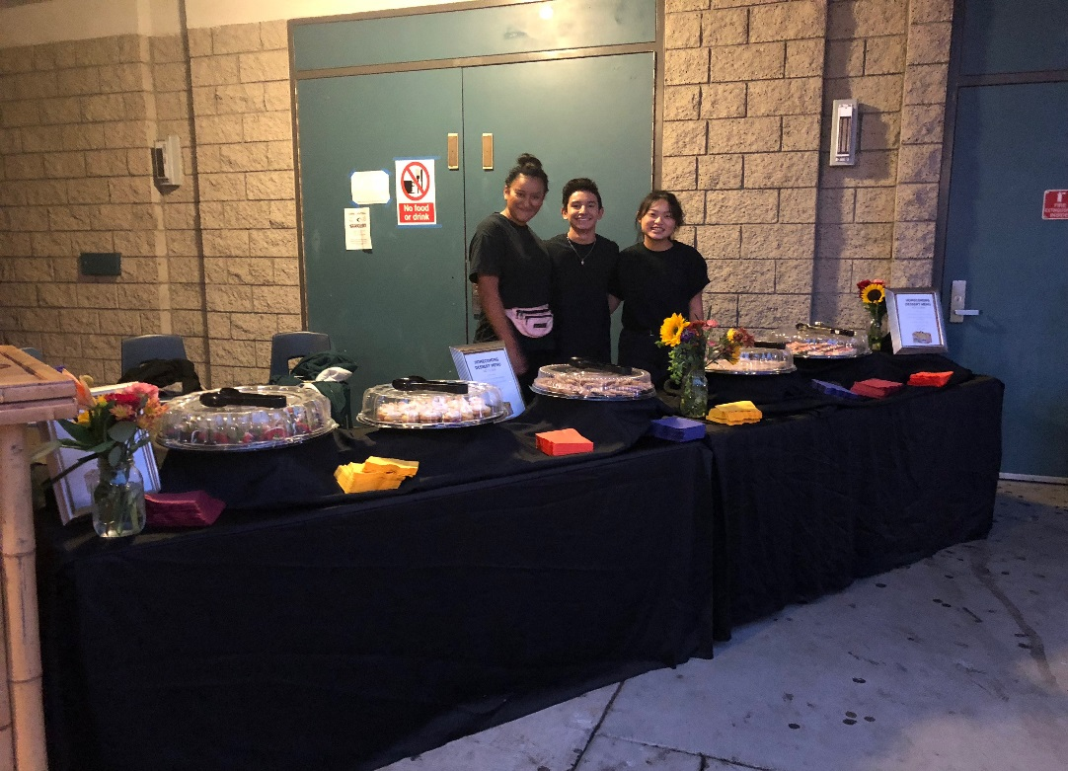
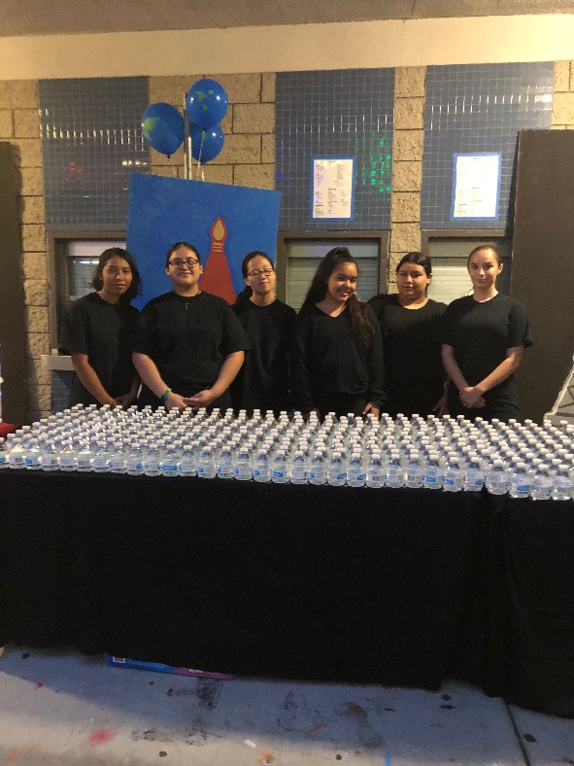
Project Based Learning

Slide 9


Project/Work Based Learning

Slide 10
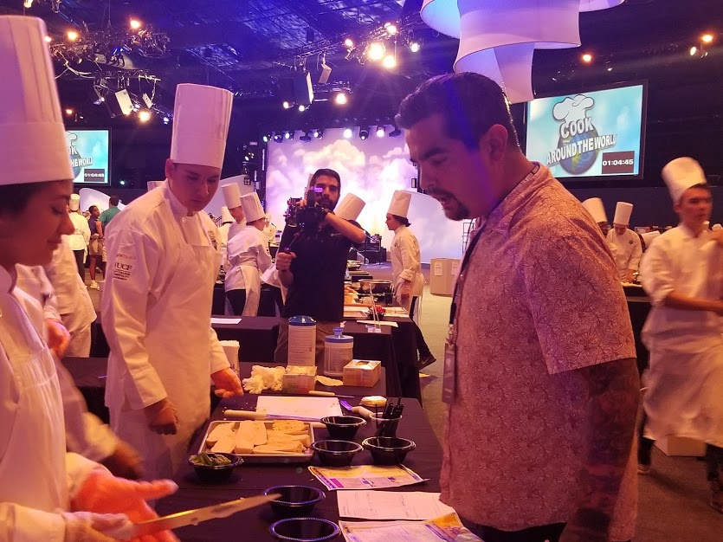


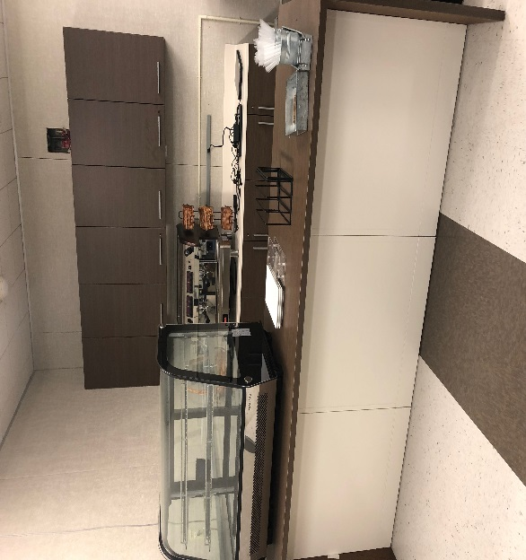
School Based Enterprise

Slide 11

CTSO
DECA prepares emerging leaders and
entrepreneurs for careers in marketing,
finance, hospitality and management
in high schools and colleges around
the globe.

Slide 12

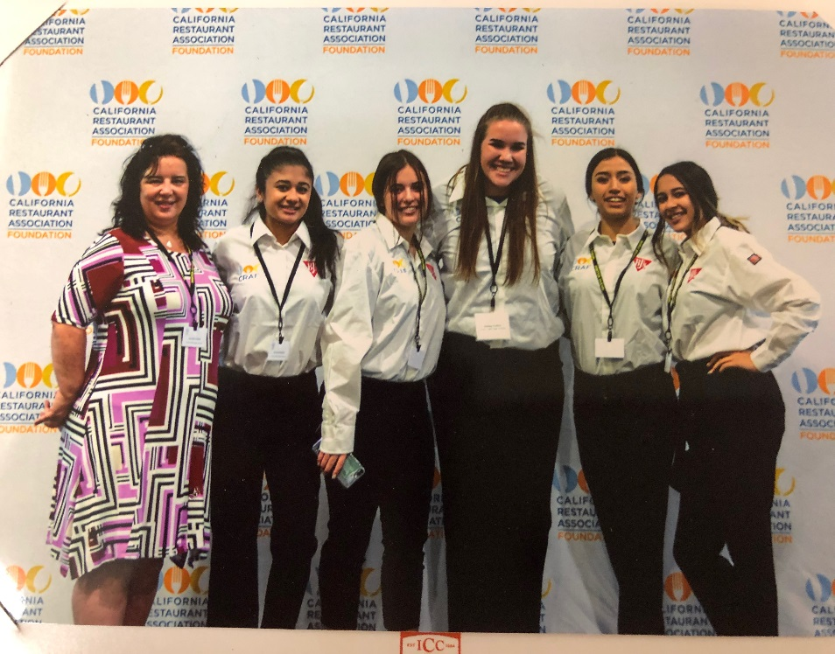
Competitive Events-Business Plans

Slide 13

Certificate of Achievement
National Restaurant Association
College Credit
Scholarship Opportunities

Slide 14
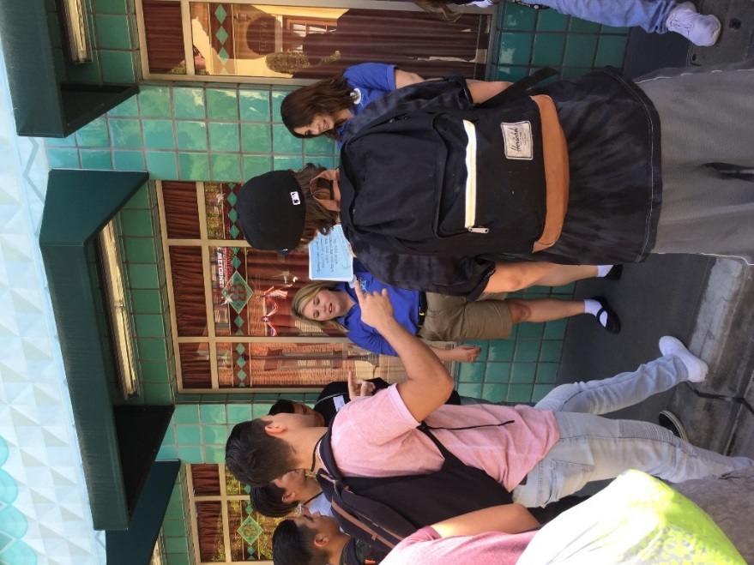
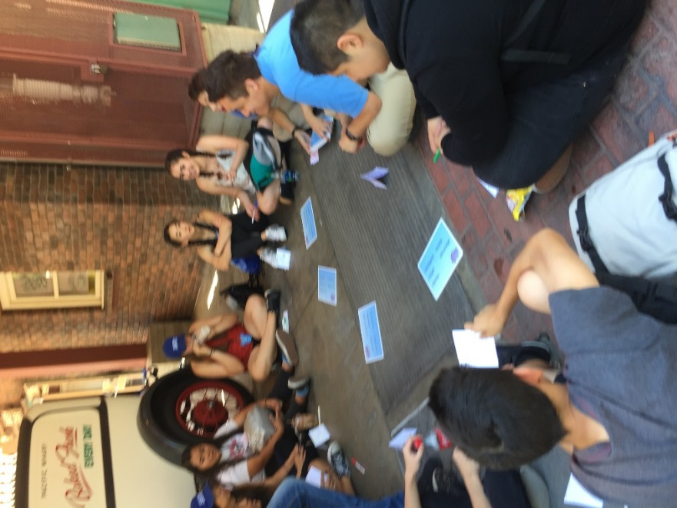
Collaboration
Youth In Education Program

Slide 15
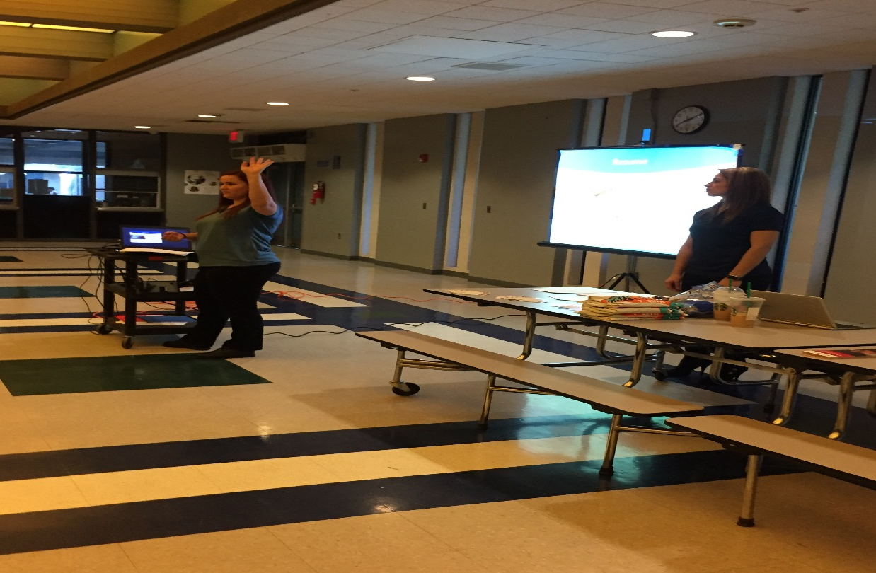
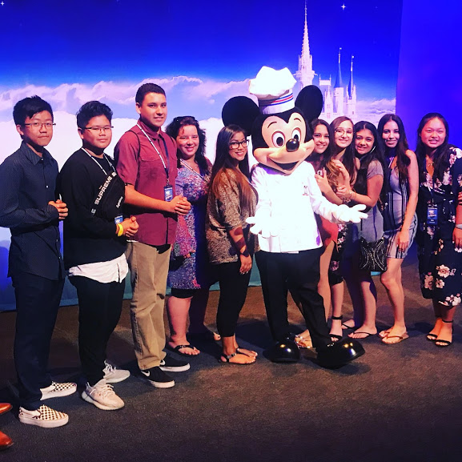
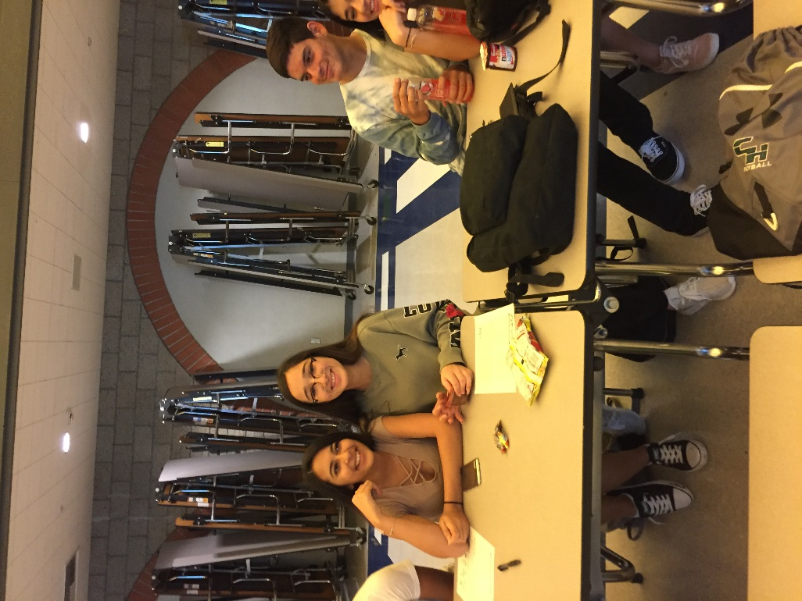
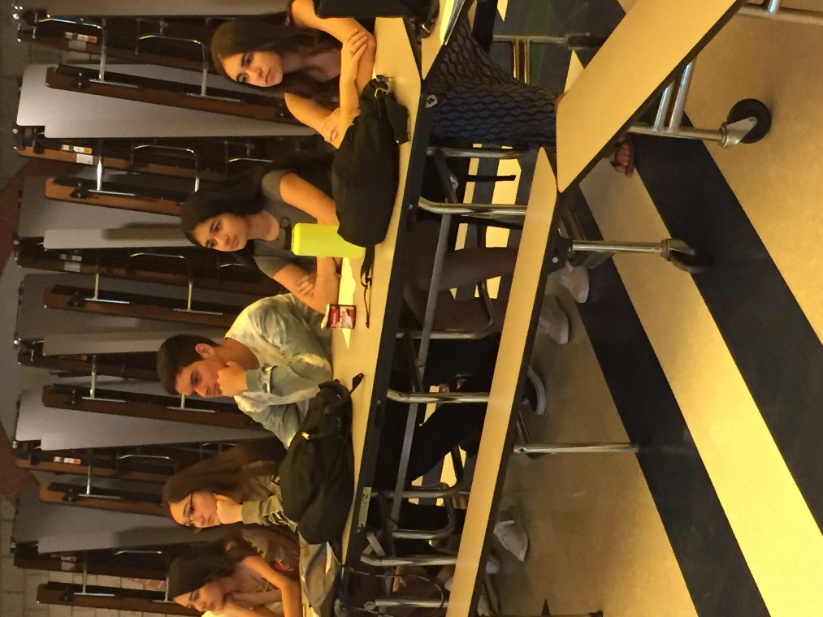
Career Development Workshops
FIT PROGRAM/Hospitality Around the World

Slide 16



Articulation Agreement
College Credit while enrolled in High School Classes

Slide 17

High Paying Management and Leadership Career Opportunities
Business/Finance
Event Planning
Food Service
Lodging
Recreation
Sports and Entertainment
Travel and Tourism
Lodging

Slide 18

Industry Specific Coursework
9th
Intro to Business
10th
Management of Hospitality
11th
Hospitality Economics
12th
Senior Project/Internships/School Based Enterprise
This Photo by Unknown Author is licensed under CC BY-NC-ND

Slide 19

9th grade schedule
  Intro to BAHT/Health
  Math
  English 9
  Visual and Performing Arts
  PE/Foreign Language
  Science

Slide 20
So what's next?
Two easy Steps
Apply online www.ChinoHillsHS.com before the March 13th
When you register, let your counselors know you want to join B.A.H.T.
Hope to see you in the Fall!!!

Slide 21
Contact info
Contact Jennell Acker
Jennell_Acker@chino.k12.ca.us

Slide 22

Join the Chino Hills High School B.A.H.T. Team Today
Questions?

